Slide 1
Machine Learning Part III SVM

Slide 2
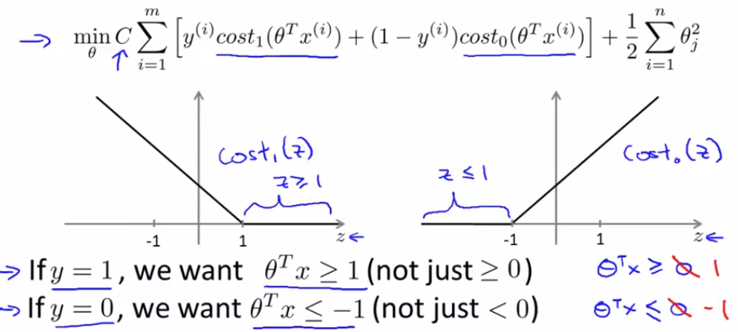

Slide 3
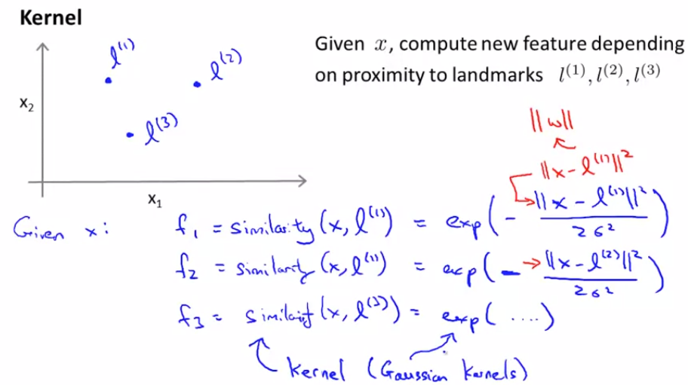
Kernels (similarity function)
Use landmarks to choose features instead of all combinations of polynomial

Slide 4
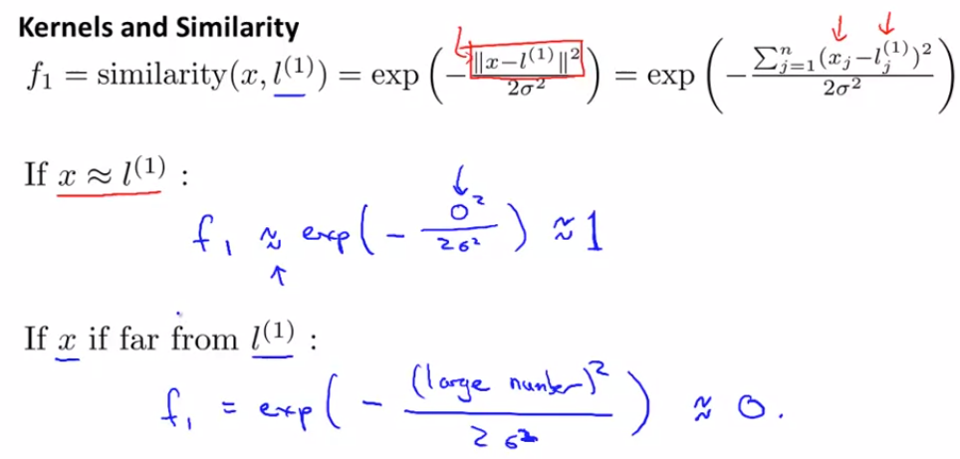

Slide 5
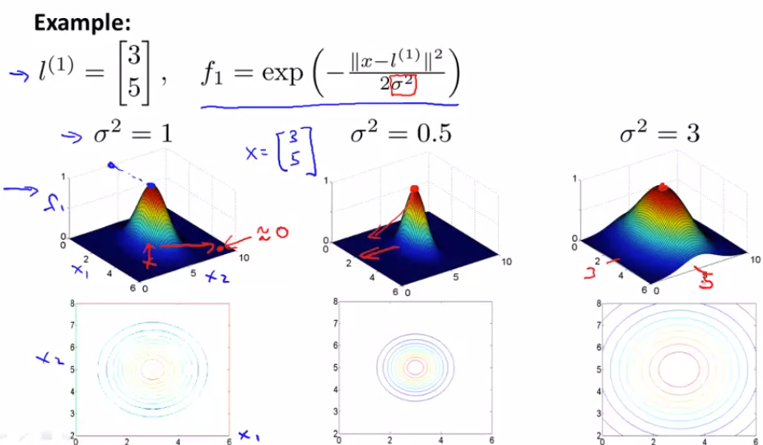
Effect of sigma

Slide 6
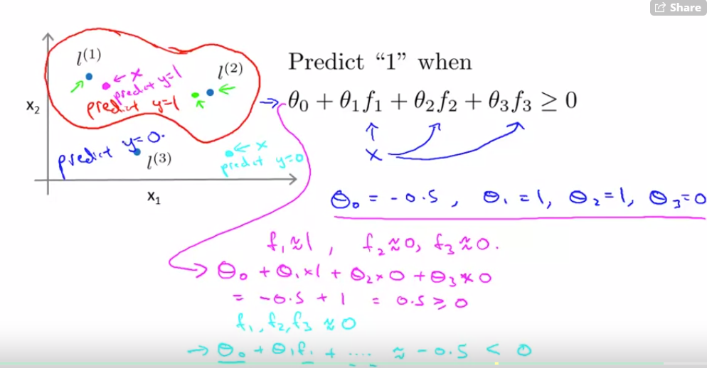
Non-linear classifier

Slide 7
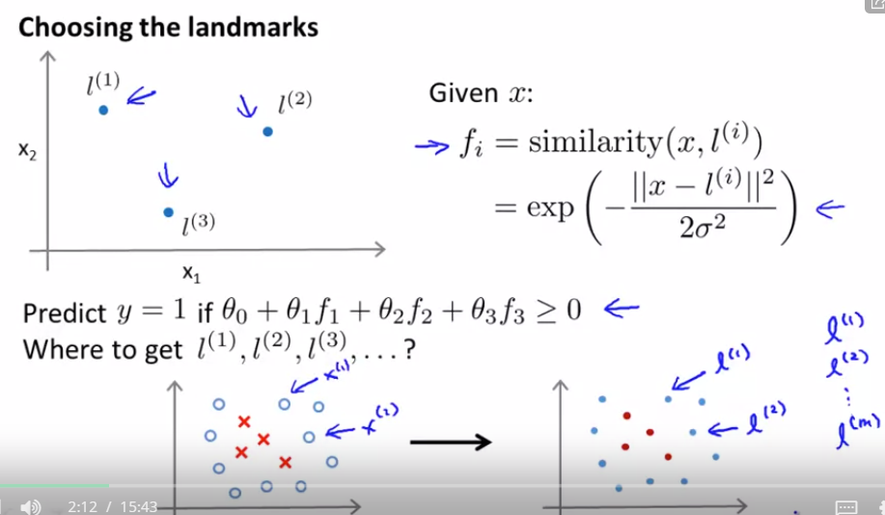
each data sample is a landmark!
each data sample becomes a feature!

Slide 8
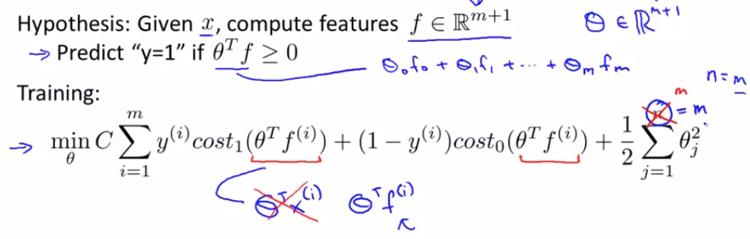
SVM with Kernels

Slide 9
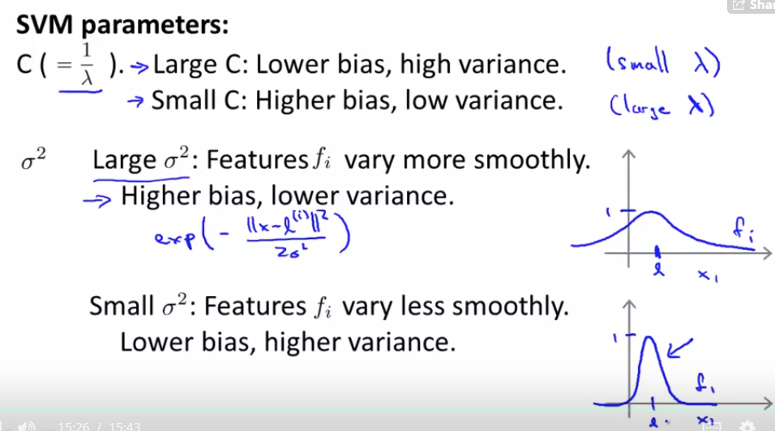
A large C parameter tells the SVM to try to classify all the examples correctly

Slide 10
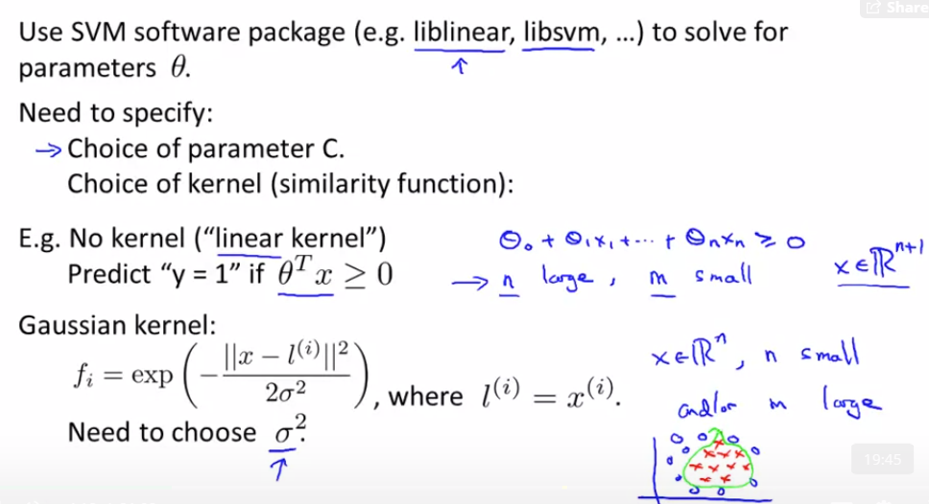
Using SVM

Slide 11
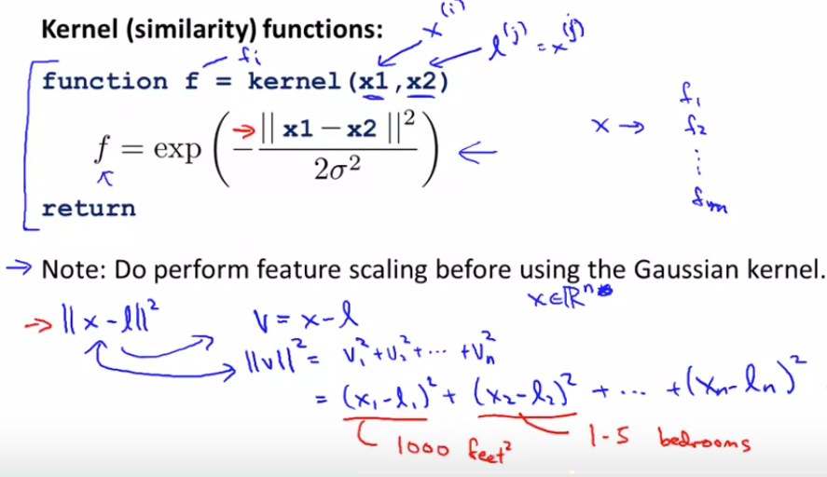

Slide 12
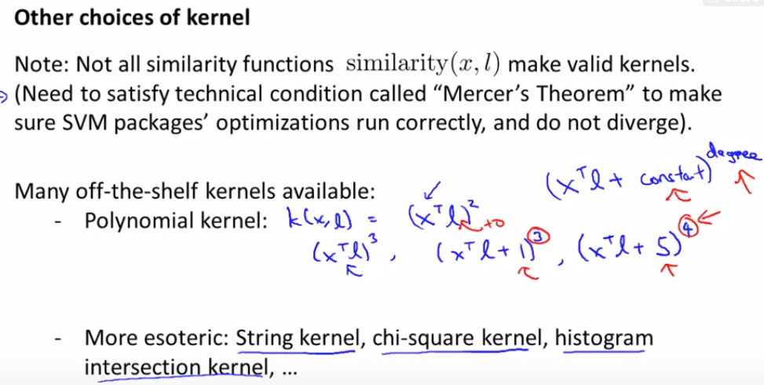

Slide 13
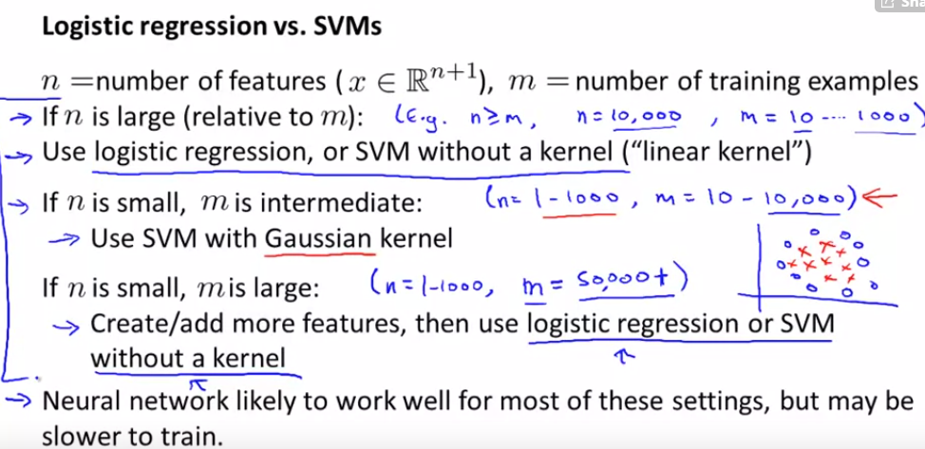

Slide 14
2.6 Optional (ungraded) exercise: Build your own dataset
TODO

